Slide 1

Hertfordshire Local Government Reorganisation:
Public Stakeholder Engagement September 2025

Slide 2
Agenda
Local Government Reorganisation: Context
Our Vision
Where We Are, and Path Forward
Options Being Considered
Questions and Feedback

Slide 3
Local Government Reorganisation: Context

Slide 4
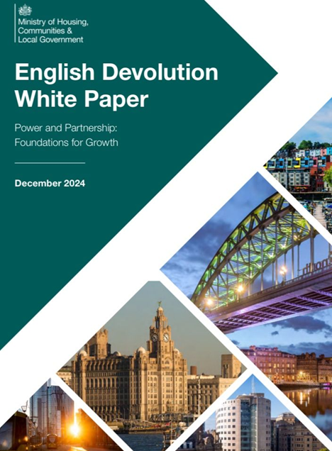
What is Local Government Reorganisation?
In late 2024, the Government set out plans to change how local councils operate. This means areas like Hertfordshire that operate a system with a County Council, and District & Borough Councils are being asked to reorganise.
That’s why the 11 council leaders in Hertfordshire are working together on a joint plan for how local government could be reshaped to better serve our communities.
This plan will be sent to the Government in November 2025.

Slide 5
What does this mean?
Strategic Authorities
Public safety
Skills and employment
Housing and strategic planning
Economic development and regeneration
Environment and climate change
Transport and infrastructure
Health, wellbeing and public service reform
One of the most significant changes to local government in past 50 years.
Furthers the Government’s ambition to decentralise power and drive local growth.
Key provisions include:
  Creation of new Strategic Authorities
  Greater local control over major areas including transport, skills, housing, environment, public safety and health
  Reorganisation of local government
Primary legislation anticipated in 2026.

Slide 6
Our Vision

Slide 7
Overview
Hertfordshire is ready for reorganisation. We want to build a system of local government informed by your voice that enables every resident and local business to flourish.
We have a once in a generation opportunity to build a new model: rooted in local identity shaped by the collective voices of our communities.
Our ambition is to preserve the distinctiveness of communities within Hertfordshire.

Slide 8
What is the vision for Hertfordshire?
Unitary Authorities
Broxbourne
Dacorum
East Herts
St Albans
Hertsmere
North Herts
Stevenage
Three Rivers
Wel-Hat
Watford
HCC
Vision: replace two-tier systems (county and district councils) with Unitary Authorities; single councils responsible for all local services
Objectives:
  Enhance local accountability
  Deliver better outcomes for residents
  Generate efficiency savings that can be reinvested in public services
All Hertfordshire authorities, plus the PCC, are working together to devise the best future arrangement for the county.

Slide 9
What is the vision for Hertfordshire?
VISION
New model for public services. We are seeking to:
Unify services around people and places
Improve governance
Deliver better outcomes through strategic planning and collaboration
GUIDING PRINCIPLES
Resident first
Prevention led
Inclusive and enabling
Partnership led
Powered by data and technology
Culturally ambitious
Strategic and place based

Slide 10
Our ambition
People-centred services designed around residents’ lives, not organisational boundaries
Integrated and efficient services which reduce duplication and improve accountability, with services which are digitally enabled, prevention-focused and financially sustainable
Place-based growth unlocking economic potential by leveraging its strategic location and sector strengths e.g. life sciences, creative industries.
Community empowerment will be central, with residents actively shaping services.

Slide 11
How does Local Government work in Hertfordshire currently?
The current local government arrangement in Hertfordshire is referred to as a two-tier system:
Hertfordshire County Council:
Children’s Services – including social care and SEND services
Adult Care Services – including services for older and disabled people
Growth and Environment - including highways and waste disposal
Public Health
Community Protection – including Hertfordshire Fire and Rescue and Trading Standards
Libraries
Registration Services (births, deaths and marriages)
District & Borough Councils
Council Tax – registering, paying and payment enquiries
Planning – new houses, extensions and shops
Housing and homelessness
Parking fines, permits and car parks
Bin collections and replacements
Licensing
Pest control
Environmental health
Leisure services

Slide 12
New arrangements in summary
STRATEGIC AUTHORITY
Sets the strategy for the area e.g., the whole of Hertfordshire or possibly further afield
Led by an elected Mayor
UNITARY AUTHORITY
Delivers local services
Covers a wide range of responsibilities previously held by county and district councils
We do not know yet how many unitary councils Hertfordshire will have
TOWN AND PARISH COUNCILS
Will continue where they currently exist
Other arrangements being considered for areas without Town and Parish councils

Slide 13
Why is it important?
This is a once in a generation opportunity to shape the future of local government in Hertfordshire.
We need your input. Our communities are in the best place to tell us what’s important to them, your voice matters.
We want to build a responsive and resilient system of local government shaped by you - one that reflects local identity while unlocking long-term benefits for residents, businesses and communities.

Slide 14
Where We Are, and Path Forward

Slide 15
What’s happened so far?
Hertfordshire’s Interim Plan submitted on 20th March
Councils and the Police and Crime Commissioner worked together to explore options including:
    A single county-wide unitary authority (we no longer believe this is the right approach to represent residents)
    A two-unitary authority model, aligned with existing economic/health partnerships
    Potential three- and four-unitary models for further analysis

Slide 16
What is the Government’s Criteria for unitary council proposals?
Seek to establish a single tier of local government.
Proposed unitary councils must be the right size to achieve efficiencies, improve capacity and withstand financial shocks. A population of 500,000 or more provides a guiding principle (rather than a target) and there is flexibility where this figure does not make sense for local areas.
Unitary structures must prioritise the delivery of high quality and sustainable public services to citizens.
Proposals should show how councils in the area have sought to work together in coming to a view and considered issues of local identity and cultural and historic importance.
New unitary structures should enable stronger community engagement and deliver genuine opportunity for neighbourhood empowerment.

Slide 17
When will LGR happen in Hertfordshire?
Strategic stakeholder engagement
Public engagement
Analysis and preparation
Submission deadline
July 2025
September 2025
September/October 2025
28 NOVEMBER 2025
VESTING DAY
(day one)
Elections to new shadow unitary authorities
Government decision
Formal government consultation on proposals
1 April 2028
May 2027
Early summer 2026
Spring 2026

Slide 18
What does this mean for Parish and Town Councils?
The government has said that they want to promote Neighbourhood Area Committees (NACs) to provide a “simplified and standardised system of local area-working and governance”.
  These could include existing parish and town councillors on their board, as well as representatives from other community organisations.
The direction of parish and town councils may come down to decisions taken locally, with input from you. We are engaging extensively with parish and town Councils and will base decisions on the views of our community.

Slide 19
What does this mean for residents?
This engagement process has laid the foundation for reorganisation. It positions us to deliver on our ambition: that every resident, in every part of Hertfordshire, can reach their full potential, and with no one left behind.
The most important changes for residents:
Simpler, faster services
  One council means a single point of contact with quicker decisions
Stronger local voice
  A larger council can speak with more authority on behalf of all residents

Slide 20
Who is leading this approach?
This is a joint cross-country effort led by:
  All district and borough Councils in Hertfordshire
  Hertfordshire County Council
  Police and Crime Commissioner
These bodies are aligning their plans to both the Government's criteria and the needs of local communities. Discussions with neighbouring areas are also underway for cross-border alignment.
They are working together to determine the best models for future local government to:
  Deliver high-quality public services
  Meet local needs
  Achieve efficiencies and ensure capacity
  Support devolution arrangements
Multiple workstreams, including service design, finance, and community empowerment, have also been set up.

Slide 21
Options Being Considered

Slide 22
What options are being considered?
When our final proposals are presented to the Government, each of the 11 Councils in Hertfordshire will indicate which of the 3 options they prefer.
After considering a wide range of options for different numbers of new councils, we have selected three options for further detailed analysis and development, and are seeking the views of residents and stakeholders on these options:
  2 unitaries
  3 unitaries
  4 unitaries

Slide 23
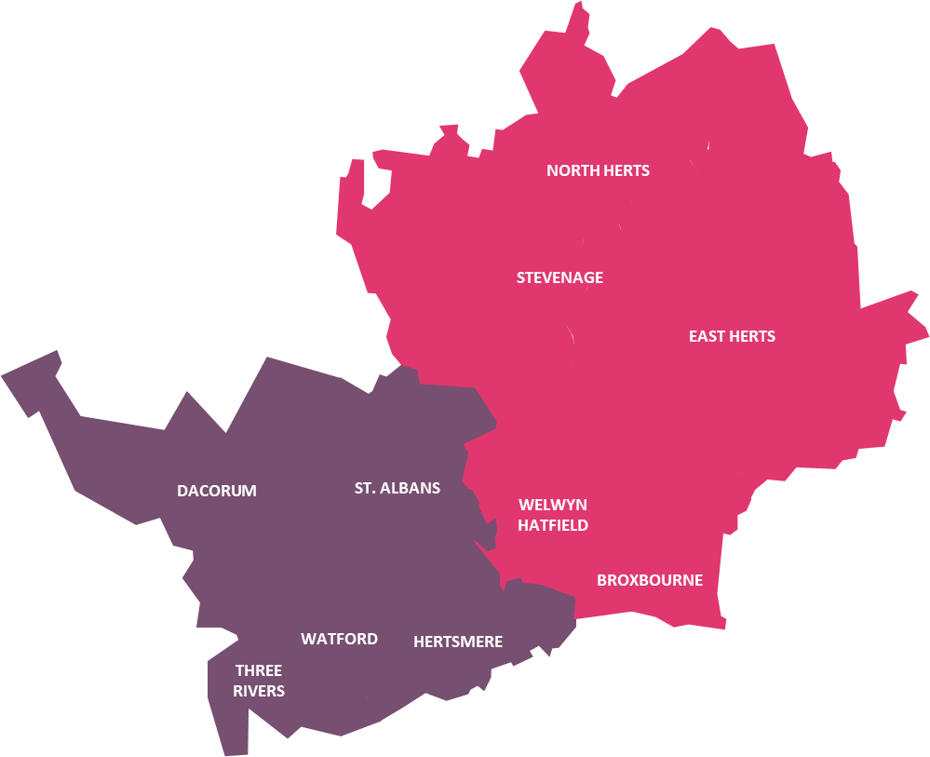
What options are being considered?
2 unitaries
Local authority | Population (mid-2024) | Population (2045)
WEST | 614,463 | 722,000
EAST | 600,924 | 758,000
West
Dacorum, Hertsmere, St Albans, Three Rivers, Watford
East
Broxbourne, East Herts, North Herts, Stevenage, Welwyn Hatfield

Slide 24
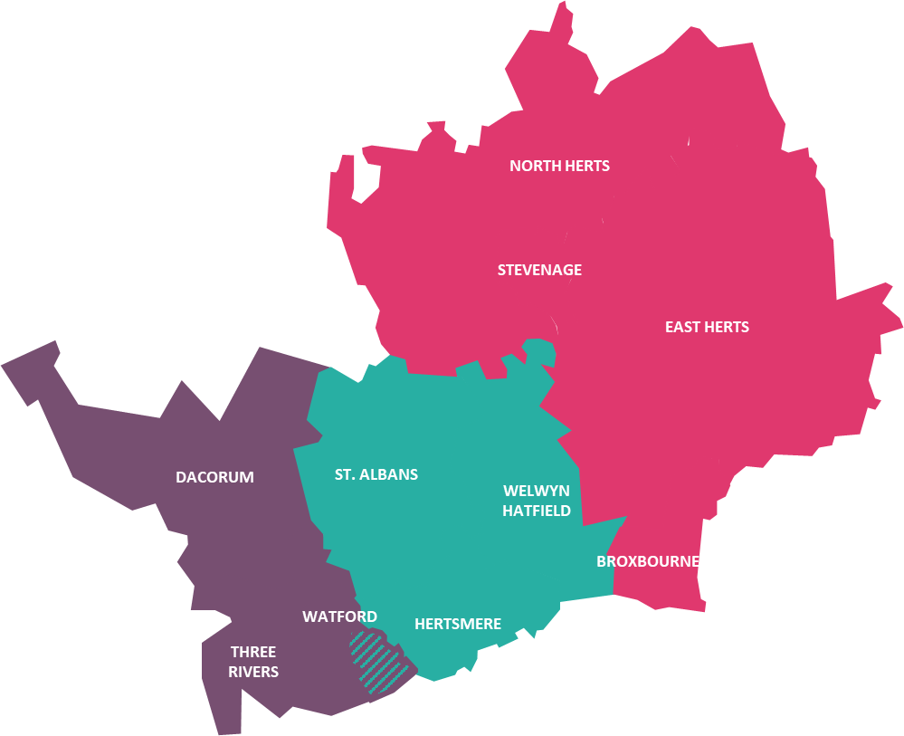
What options are being considered?
3 unitaries
Local authority | Population (mid-2024) | Population (2045)
WEST | 386,013 | 463,000
CENTRAL | 350,199 | 414,000
EAST | 479,175 | 603,000
West
Dacorum, Three Rivers, Watford PLUS Bushey North & Bushey South County Electoral Divisions
Central
Hertsmere, St Albans, Welwyn Hatfield MINUS Bushey North & Bushey South County Electoral Divisions
*The striped area on the map shows a potential boundary change between Watford and Hertsmere. We are considering this as part of the LGR process, as it could improve services where the current boundary splits communities.
East
Broxbourne, East Herts, North Herts, Stevenage

Slide 25
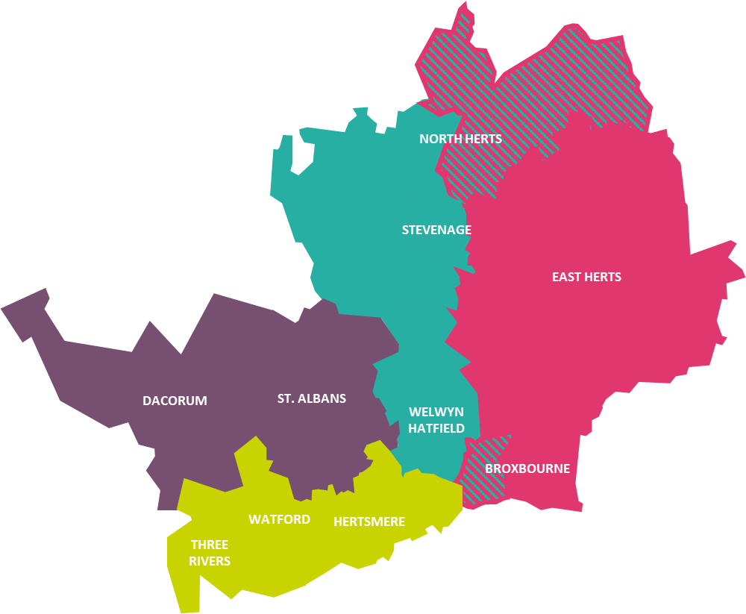
What options are being considered?
4 unitaries
Local authority | Population (mid-2024) | Population (2045)
WEST | 306,582 | 351,000
SOUTH-WEST | 307,881 | 371,000
CENTRAL | 316,013 | 391,000
EAST | 284,893 | 366,000
West
Dacorum, St Albans
South West
Hertsmere, Three Rivers, Watford
Central
North Herts, Stevenage, Welwyn Hatfield MINUS Royston Heath, Royston Palace, Royston Meridian, Ermine, Weston & Sandon, Arbury wards from North Herts District Council AND Northaw & Cuffley Ward from Welwyn Hatfield District Council.
*The striped areas on the map show potential boundary changes. We are considering these as part of the LGR process, as they could better reflect existing communities and economies.
East
Broxbourne, East Herts PLUS Royston Heath, Royston Palace, Royston Meridian, Ermine, Weston & Sandon, Arbury wards from North Herts District Council AND Northaw & Cuffley Ward from Welwyn Hatfield District Council.

Slide 26
Questions and Feedback

Slide 27
Providing Feedback
We are united in wanting to hear from as many people, businesses and organisations in our local communities as possible.
Please visit Hertfordshire’s dedicated LGR website for full information: www.hertfordshire-lgr.co.uk
Once you have explored the website, complete the engagement survey here: https://freeonlinesurveys.com/s/LNoAgAHR/i/0
You can also share your views directly with us at hertfordshirelgr@connectpa.co.uk

Slide 28
Thank You

